Slide 1
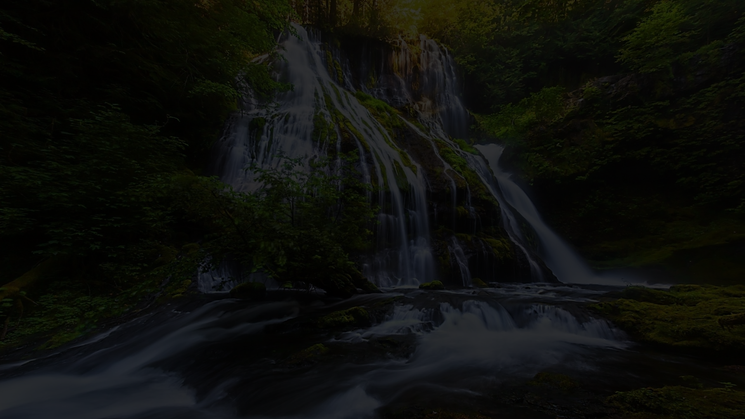

The Water Footprint
Water footprint refers to the total volume of fresh water used for the production of goods and services used by an individual or a community. It’s important to be aware of your water footprint and find ways to reduce it.

Slide 2
The Importance of Measuring Water Footprint
1
Reducing Water Scarcity
2
Identifying Environmental Impacts
3
Encouraging Responsible Consumption
Water scarcity is a significant issue in many parts of the world. By measuring your water footprint, you can take steps to reduce it and conserve this precious resource.
Measuring water footprint also helps in identifying the environmental impact of a product or service. This information is useful to manufacturers and producers to make better decisions.
Understanding the water footprint of various products and services can motivate individuals and communities to make responsible consumption choices.

Slide 3
Types of Water Footprints
Blue Water Footprint
Green Water Footprint
Grey Water Footprint
Refers to the amount of surface and groundwater consumed. It includes both the quantity and quality of water used for domestic, industrial and agriculture purposes.
Refers to the volume of rainwater consumed for the growth of crops and other vegetation. It is the volume of water that has evaporated from the soil and transpired by plants.
Refers to the amount of freshwater required to assimilate the pollutants released into the water bodies. It is the volume of water required to dilute the pollutants to safe levels.

Slide 4
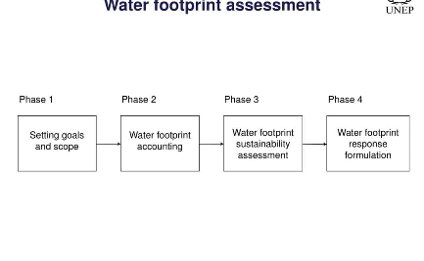
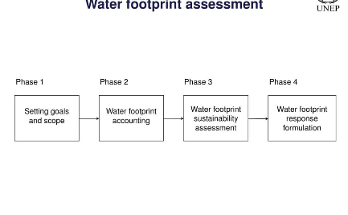
Water Footprint Flowchart
Agriculture
Industry
Domestic
This sector is the largest contributor to total water footprint. Irrigating crops, raising livestock, and processing food all require water.
The industrial sector has a significant impact on the water footprint, particularly through manufacturing processes that require high levels of water use and pollution.
Domestic water footprints include the water consumed by households for personal and household sanitation needs.

Slide 5
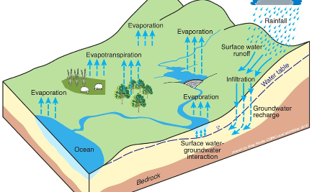
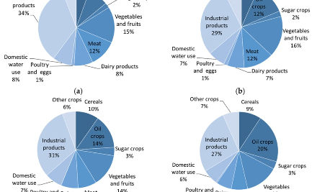
Water Footprint Block Diagram
Production
Utilization
Disposal
Producing goods and services requires water for raw material extraction, processing, packaging and transportation.
Consumers use water in their day to day activities and purchases, from food and drink to clothing and electronics.
Disposing of goods and services requires water in the form of wastewater treatment, recycling, and landfilling.

Slide 6
Calculating Your Own Water Footprint
Gather Data
Categorize Usage
Collect information on your consumption of water and water-intensive products to determine your water consumption.
Categorize your usage into blue, green, and grey water footprints to identify areas to optimize.
Calculate
Monitor & Evaluate
Calculate the volume of water used and evaluate ways to conserve and reduce water usage.
Track and evaluate changes to determine the impact of your efforts to reduce the water footprint.

Slide 7
Reducing Your Water Footprint
Change Your Diet
Reduce Household Water Usage
Choose Water-Efficient Products
Reducing meat consumption, eating seasonally and locally, and reducing processed foods can help reduce your water footprint.
Reducing shower time, using water-efficient appliances, and catching rainwater to water houseplants can make a big difference.
Choosing household appliances and products with good water efficiency ratings can help reduce your water footprint.

Slide 8
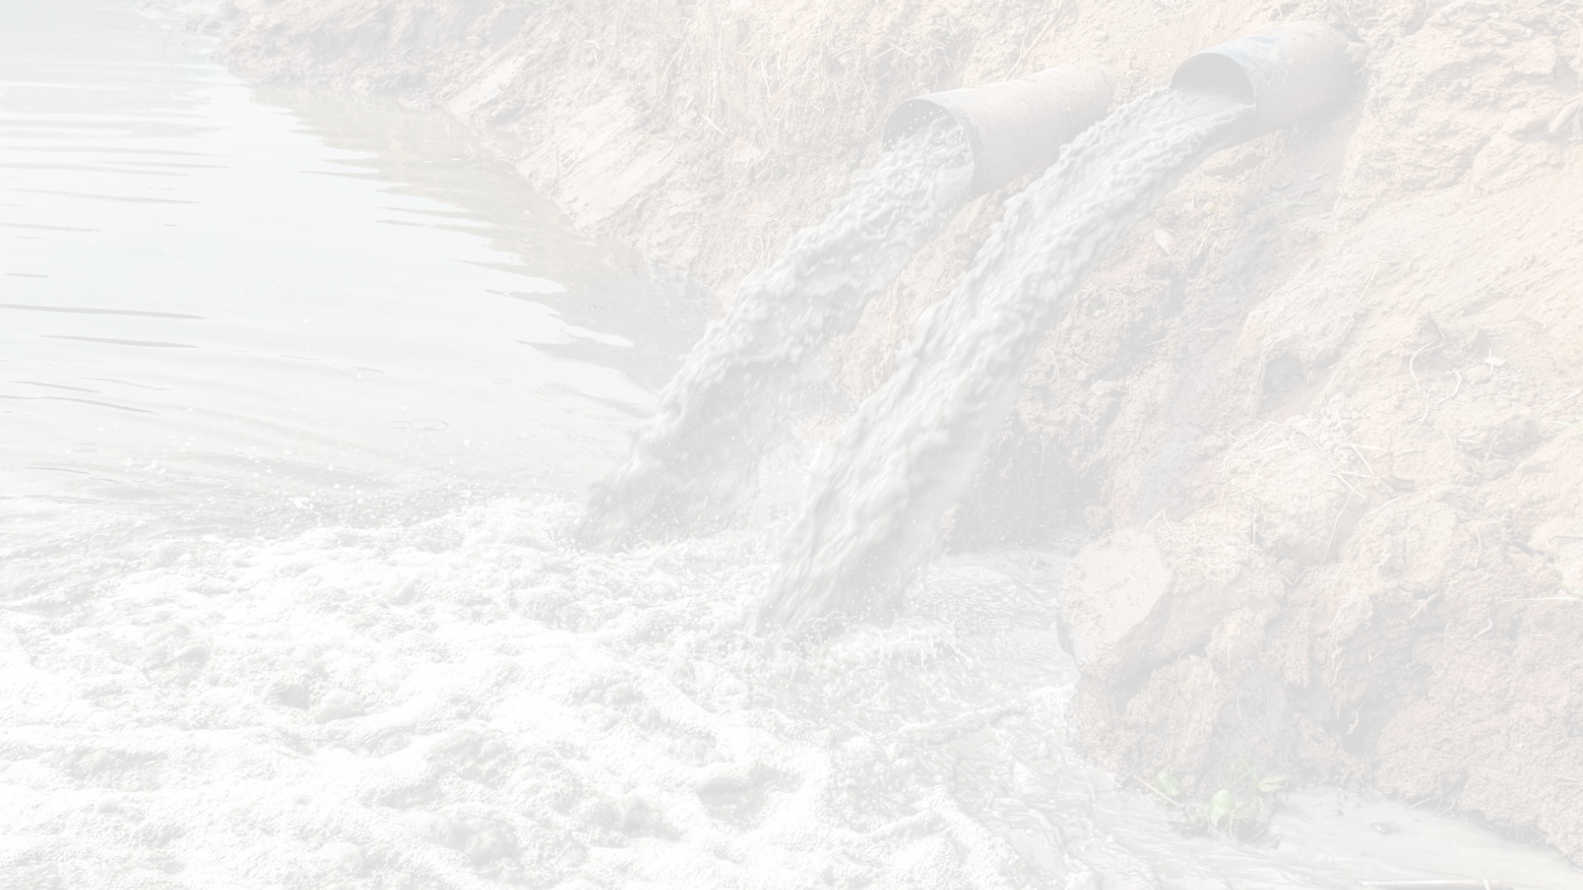
Impact on the Environment
Excessive water use can have serious environmental consequences, including reduced water availability in rivers and aquifers, and reduced water quality due to pollution and contamination. By reducing your water footprint, you can help protect the environment.

Slide 9
Resources for More Information
Water Footprint Network
WWF
UNESCO
Learn about the environmental impact of water use and how to take action to conserve water.
Access resources on water management and sustainable development goals.
Access tools and resources to help measure and manage your water footprint.
Visit Website
Visit Website
Visit Website

